Slide 1
Requirements Elicitation
31269: Business Requirements Modelling
Week 3 Lecture
Week

Slide 2
Objectives
Plan for and carry out elicitation of requirements from stakeholders and other sources
Understand the benefits and drawbacks of different elicitation techniques
Identify appropriate technique for eliciting requirements for a given situation
Understand the differences between requirements elicitation for existing systems vs the new system

Slide 3
Topics
Requirements Elicitation Process
Techniques for eliciting requirements
Interview
Questionnaires/Survey
Observation
Prototyping with ‘Wireframes’
Requirements Workshop

Slide 4
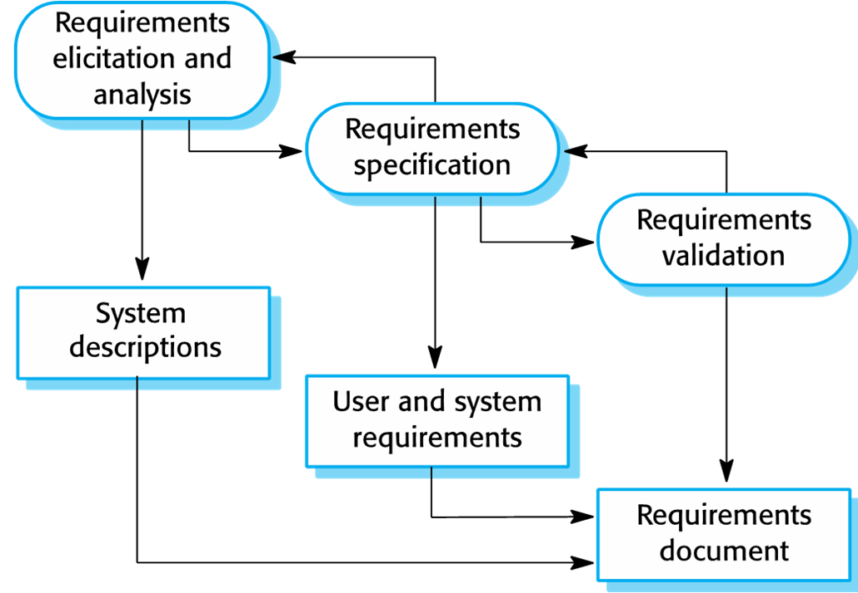
Requirements Process

Slide 5
Requirements Elicitation Process
The following activities could be included in any requirements elicitation process:
Understanding the application domain & the properties of the existing system
Identifying the sources of requirements
Identifying and analyzing all the relevant stakeholders
Selecting the approaches, techniques and tools for elicitation
Eliciting the requirements from the stakeholders and other sources using the selected techniques, approaches and tools

Slide 6
Present versus Future system
Get a clear understanding of
The overall objectives of the enterprise
What do individual users of the system want to achieve in their job
Understand
How the business is operating at present
How people are working right now and what they cannot do with the existing system
The problems with and inadequacies of the current system
Hence, discover the “new requirements”
Notes:
Many aspects of the current system will need to be carried forward into the new system, so it is important that information about what people are doing is gathered and documented. These are the requirements that are derived from the “current system”. The motivation for the development of a new information system is usually problems with and inadequacies of the current system. So it is also essential to capture what it is that the users require of the new system that they cannot do with their existing system. These are “new requirements”

Slide 7
Requirements Elicitation Techniques - Interview
An interview is a systematic approach designed to elicit information from a person or group of people.
One-on-one interviews are typically most common.
In a group interview (with more than one interviewee in attendance) the interviewer must be careful to elicit responses from all attendees.
Interviewer formally or informally directs questions to a stakeholder.
Used to explore issues and can collect some quantitative, but mostly qualitative data.
Widely used elicitation and fact finding technique and requires the most skill and sensitivity.

Slide 8
Requirements Elicitation Techniques - Interview
Requires good planning and preparation, good interpersonal skills and an alert and responsive frame of mind during the interview, and good analysis skills post interview.
Ensure that the biases and predispositions of the interviewer do not interfere with a free exchange of information.
Structured Interview: where the interviewer has a pre-defined set of questions and is looking for answers.
Unstructured Interview: where, without any pre-defined questions, the interviewer and the interviewee discuss topics of interest in an open-ended way.

Slide 9
Preparing for interviews
Establish the objective for the interview
Determine relevant stakeholders to be involved
Determine project team members to participate
Build a list of questions and issues to be discussed
Review related documents and materials
Set the time and location
Inform all participants of objective, time and location

Slide 10
Conducting interviews
Arrive on time and take responsibility for the agenda
Stick to the planned timetable, do not over-run
If you plan to tape the interview, ask the interviewees permission but take notes as well.
Probe for details by using different types of questions
Take thorough notes
Identify and document unanswered items or open questions

Slide 11
Interview Guidelines
Plan and organize
Start with high level general questions
Ask specific questions
Seek lead for more information from stakeholders
Keep it to 1-2 hours
Take and share meeting notes and minutes
Record following up and action items
Focus on “Project” and not the people
Ask, listen, probe, understand and record (ALPUR)
Avoid blaming, jargons, forcing your opinion

Slide 12
Interview Approach – the Don’ts
Never show aggression nor create an impression of apportioning blame.
Do not force solutions on users- play role of an advisor and facilitator
Explain limitations of the system in user terms
Describe how system will help users in their work
Do not ask leading questions, ask for suggestions for improvement and follow them up.
Notes:
Never show aggression nor create impression of apportioning blame.
“I’ve been told there are some major issues in this area and it’s my job to fix them”
“Conducting a study to identify how we can provide you with better support for your work…”
Do not ask leading questions, ask for suggestions for improvement and follow them up
Not many yes no questions – they are usually leading questions

Slide 13
Open Questions
Encourage spontaneous and unstructured responses.
General questions establishing a viewpoint
Question that requires a full answer
Open-ended questions begin with the following words: why, how, what, describe, tell me about..., or what do you think about...
Examples of open-ended questions are:
"What happened after I left?“
"Why did Jim leave before Susan?"
"Tell me about your day at work."
"What do you think about the new season of this TV show?“
“Is there anything else I should be asking you?” (Your last question of the interview)
Notes:
Open questions develop rapport
Shy or uncooperative interviewees may respond better to closed questions, so warm up with them
Different types of questions:
Open-ended questions encourage spontaneous and unstructured responses.
Close ended questions limit or restrict the response
Range-of-response questions are close ended questions that ask person to evaluate something by providing limited answers to specific responses or on a numeric scale. This method makes it easier to tabulate the answers and interpret the result.

Slide 14
Closed Questions
Question that can be answered by single word (yes or no) or a short phrase.
They are used to obtain facts and specific pieces of information.
Restrict the response requiring specific answer such as a number, explanation of a report, reason for an action”
Examples of closed-ended questions are:
"Who will you choose?"
"What brand of car do you own?"
"Did you speak to Bob?"
"Did Susan leave with Jim?"

Slide 15
Probes
Probes are a
Follow up from a previous answer
“Why do you…”
“Where do you…”
“How often do you…”
Most interviews use a combination of all three question types. The approach you take will depend on the type/role of interviewee

Slide 16
Concluding and evaluating interviews
Thank interviewees for their time. Offer to provide them with a copy of your notes for them to validate. Make an appointment for further interviews if needed.
Review and transcribe your tapes or notes ASAP after the interview while the content is still fresh in your mind.
Review your notes for accuracy, completeness, consistency and understanding.
Transfer information to appropriate models and documents.
Identify areas needing further clarification.
Send interviewees your notes and update your notes to reflect their comments.

Slide 17
Advantages and disadvantages of Interviews
Advantages
Allows the interviewer and participant to have full discussions and explanations of the questions and answers.
Personal contact allows responsiveness and adapting to what the user says.
Analyst can probe in greater depth than any other methods of elicitation
Allows interviewees to express opinions in private that they may be reluctant to express in public.
Disadvantages
Can be time consuming and costly. Requires considerable commitment and involvement of the participants.
Interview results have to be transcribed and written and transcription and analysis of interview data can be complex and expensive.
Can be subject to bias
If conflicting information is given, it can be difficult to resolve and interviews are not an ideal means of reaching consensus across a group of stakeholders.
There is a risk of unintentionally leading the interviewee.

Slide 18
Requirements Elicitation Techniques – Surveys/Questionnaires
A Questionnaire or “Survey” is a document containing a number of standard questions that can be sent to individuals to obtain information from a large number of people or when the people are geographically dispersed.
So, you could send these list of questions to your stakeholders asking them about the new system or the changes to the existing system
Can collect both quantitative and qualitative data.
They are also appropriate for systems that will be used by the general public and where the analyst has to investigate all the types of users of the system.

Slide 19
Types of Questions
Yes/No questions:
e.g. “Do you print reports from existing system?” Yes No (please circle one)
Multiple Choice questions:
e.g. How many clients do you obtain in a year?
a) 1-10
b) 11-20
c) 21-30
d) 31 +
Scaled Questions: e.g. How satisfied are you with the response time of the stock update? (please circle one option) 1. Very satisfied 2. Satisfied 3. Dissatisfied
Open-ended questions e.g. What additional reports would you require from the system?

Slide 20
Advantages and disadvantages of Surveys
Advantages
An economical and quick method of gathering data from a large sample.
Can reach many people with low resource.
Used for answering specific questions.
Can be administered remotely.
Depending on how well it is designed, the results can be analysed easily by software applications.
Effective and efficient when stakeholders are not located in one location.
Disadvantages
Effective questionnaires are hard to design (e.g. leading questions, misinterpretation of questions).
Questions are usually not answered completely.
The response rates for surveys can be too low for statistical significance.
There is no automatic way of follow up unless you do interviews later.

Slide 21
Requirements Elicitation Techniques - Observation
Analyst observes the actual execution of existing processes by the users (study a stakeholder’s work environment), usually without direct interference.
Seeing the environment and domain where the system will be situated in action gives additional perspectives and a better understanding of system functionalities.
Observe system as it actually behaves.
Observation also allows us to verify statements made in interviews and surveys to determine whether the procedures within the domain really operate as they were described.
you might discover that neither the system documentation nor the interview statements are accurate.
Notes:
Through observation you might discover that neither the system documentation nor the interview statements are accurate.
Recommendations are often better accepted when they are based on personal observation of the actual operation.
People are not good at estimating quantitative data, such as how long they take to deal with certain tasks and observation with a stop watch can give the analyst plentiful quantitative data, not just about typical times to perform a task but also about the statistical distribution of those times.
Open-ended where the analyst simply sets out to observe what happens to note it down
Close-ended where the analyst wishes to observe specific aspects of the job and draws up an observation schedule or form on which to record data.

Slide 22
Requirements Elicitation Techniques - Observation
Direct gathering of information rather than through description.
Individual behaviour maybe altered because they know they are being studied.
Avoid disturbing users from their normal activities.
Two types of Observations:
Passive: You don’t ask questions, simply observe and make notes.
Active: You observe and have a dialog with the users/stakeholders while they are performing their work.
It is useful in situations where different interviewees have provided conflicting information about the way existing system works.
Observation is essential for gathering some quantitative and mostly qualitative data about people’s jobs.

Slide 23
Guidelines for observation
Ask enough questions to ensure that you have a complete understanding of the present system.
Document any procedures for handling exceptions
Consider each user who works with the system
What information does that person receive from other people?
What information does this person generate?
How is this information communicated?
How often do interruptions occur?
How much down time occurs?
How much support does the user require and who provides it?

Slide 24
Advantages and disadvantages of Observation
Advantages
Provides first hand experience of the way the current system works
Data is collected in real time and can have a high level of validity
Can be used to verify information from other sources or to look for exceptions
Baseline data about the performance of the existing system and of users can be collected
Disadvantages
Could be very time consuming
Need to analyse huge amounts of data
Most people do not like to be observed and may be disruptive to the person being observed.
Requires trained and skilled observer to be most effective.
There may be ethical problems if the person being observed deals with sensitive private or personal data or directly with members of public.
There may be logistical problems if the staff being observed work shifts.
Unusual exceptions and critical situations that happen infrequently may not occur during the observation.

Slide 25
Requirements Elicitation Techniques - Prototype
A prototype is an initial working model of a larger, more complex entity, usually a program with limited functionality that is built to test out some aspect of how the final system will work (and look like) and then present it to the stakeholders.
Prototypes may be constructed with various objectives in mind:
To investigate user requirements
To test specific concept or verify an approach
To focus on human-computer interface
Investigate input and output and its form
Investigate most suitable interface

Slide 26
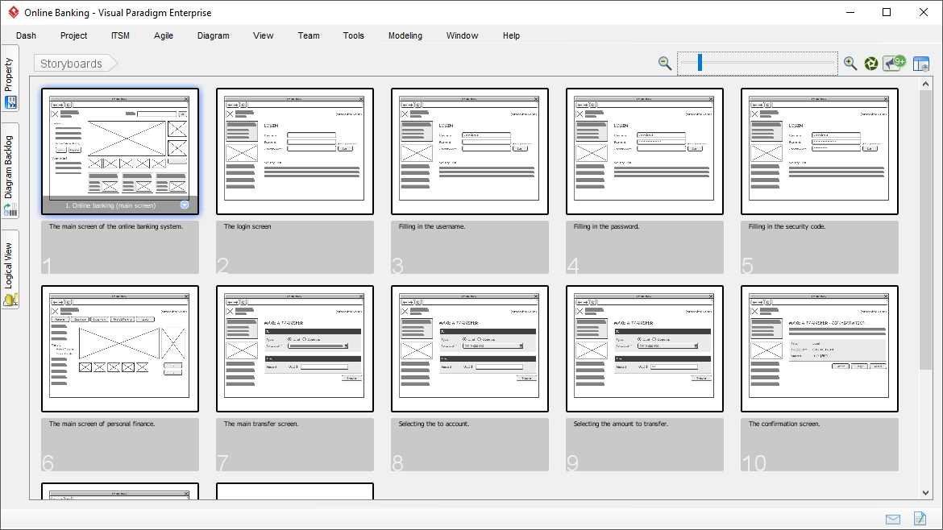
Example UI flow: Online banking system

Slide 27
Storyboard/Wireframes (UI flows) – part of assessment 4
UI flows or storyboarding (wireframes): A storyboard is a series of drawings used mostly for identifying user interfaces; screens that the software will display are drawn.
User interface-flow diagrams (Storyboards/Wireframes) offer a high-level view of the interface of a system, you can quickly gain an understanding of how the system is expected to work. You can then validate the overall flow of your application's user interface. For example, does the flow make sense?
User interface-flow diagrams are used to model the interactions that users have with your software, as defined in a single use case.
They also enable you to gain a high-level overview of the user interface for your application.

Slide 28
Advantages & Disadvantages of prototype
Advantages
allows for early user interaction and feedback.
Supports users who are more comfortable and effective at articulating their needs by using pictures, as prototyping lets them “see” the future system’s interface.
A vehicle for designers and developers to learn about the users’ interface needs and to evolve system requirements.
Disadvantages
Depending on the complexity of the target system, using prototyping to elicit requirements can take considerable time.
A prototype may lead users to develop unrealistic expectations regarding the delivered system’s performance, completion date, reliability and usability characteristics. This is because an elaborated, detailed prototype can look a lot like a functional system.

Slide 29
Requirements Elicitation Techniques – Requirements Workshop (Focus Groups)
A technique used to expedite requirements elicitation, also referred to as “Joint Application Development” or “focused groups”.
The objective is to compress all of the activities involved in other fact finding techniques into a shorter series of workshop sessions with users and project team members.
These sessions are usually conducted in special rooms with supporting facilities: overhead projector, a white board, flip charts, adequate workspace for the participants.

Slide 30
Requirements Workshop Fundamentals
A workshop may be used to scope, discover, define, refine, update, prioritize and reach closure on requirements for the target system.
A workshop may be used to generate ideas for new features or products, to reach consensus on a topic or conflicting views, or to review requirements.
Organised process: uses techniques such as brainstorming, top-down analysis, etc.
Documented approach: output of each session is documented in such a way to make it easy to read and understand and agree upon.

Slide 31
Requirements Workshop Guidelines
Participants must be selected carefully representing different classes of stakeholders.
Ensure that all stakeholders participate and have their input heard.
Must have a skilled facilitator (you as a BA).
You should remain neutral and promote discussion.
Meeting room should have all the necessary facilities and the environment be conducive to hold effective meetings
Need visual aids (e.g. flip charts, whiteboard, large screens, GUI)

Slide 32
Requirements Workshop
Goal and Agenda
Elicitation, Review, Sign Off workshops
Who…10-15 people max.
Location and time
Facilitator
Subscriber
Tools
Food
Ice breaker
Follow-up

Slide 33
Advantages & Disadvantages of Workshop
Advantages
Workshop sessions are very successful in reducing project development efforts and shortening the schedule.
Used to generate ideas for new features or products.
To reach consensus on a topic or conflicting views.
Is able to gauge reaction to stimulus material (e.g. storyboards, screenshots).
A requirements workshop provides a means for stakeholders to collaborate, make decisions and gain a mutual understanding of requirements.
Disadvantages
Risk involved in speeding up the decisions. Sometimes the decisions made about the requirements are not optimal.
May suffer from dominance.
At times, details are inappropriately defined or missed altogether.

Slide 34
Summary of elicitation techniques
Techniques for eliciting requirements
Interviews
Questionnaires/Survey
Observation
Prototypes with Wireframes
Requirements Workshops

Slide 35
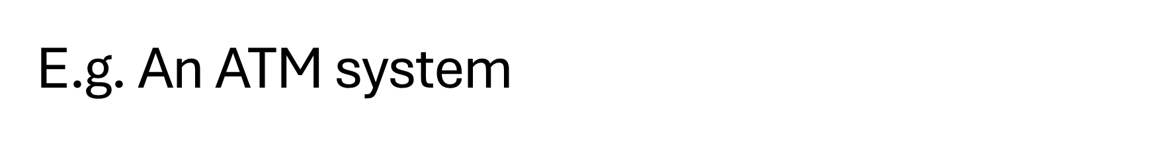
Using interview technique to elicit requirements
(will discuss further in the lecture)
Examples Questions/answers to elicit FR and NFR
Functional requirements
Does the ATM need to have a proof of transaction system?
ATM should print receipts as a record of transactions
Nonfunctional requirements
How fast will the processing speed be?
We want to keep all interactions with the ATM under 2-3 minutes, no noticeable slow down even with large transactions/withdrawals

Slide 36
Example requirements statements
(will discuss further in the lecture)
The ATM must allow users to withdraw, deposit, view their account balance and transfer money. Functional requirement statement
The ATM should have a touchscreen and pin pad interface, and all actions should be processed and performed in under 2 minutes Non functional requirement statement

Slide 37
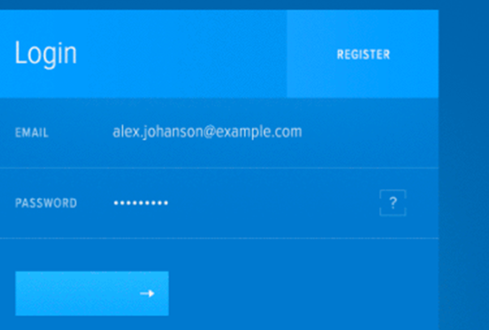
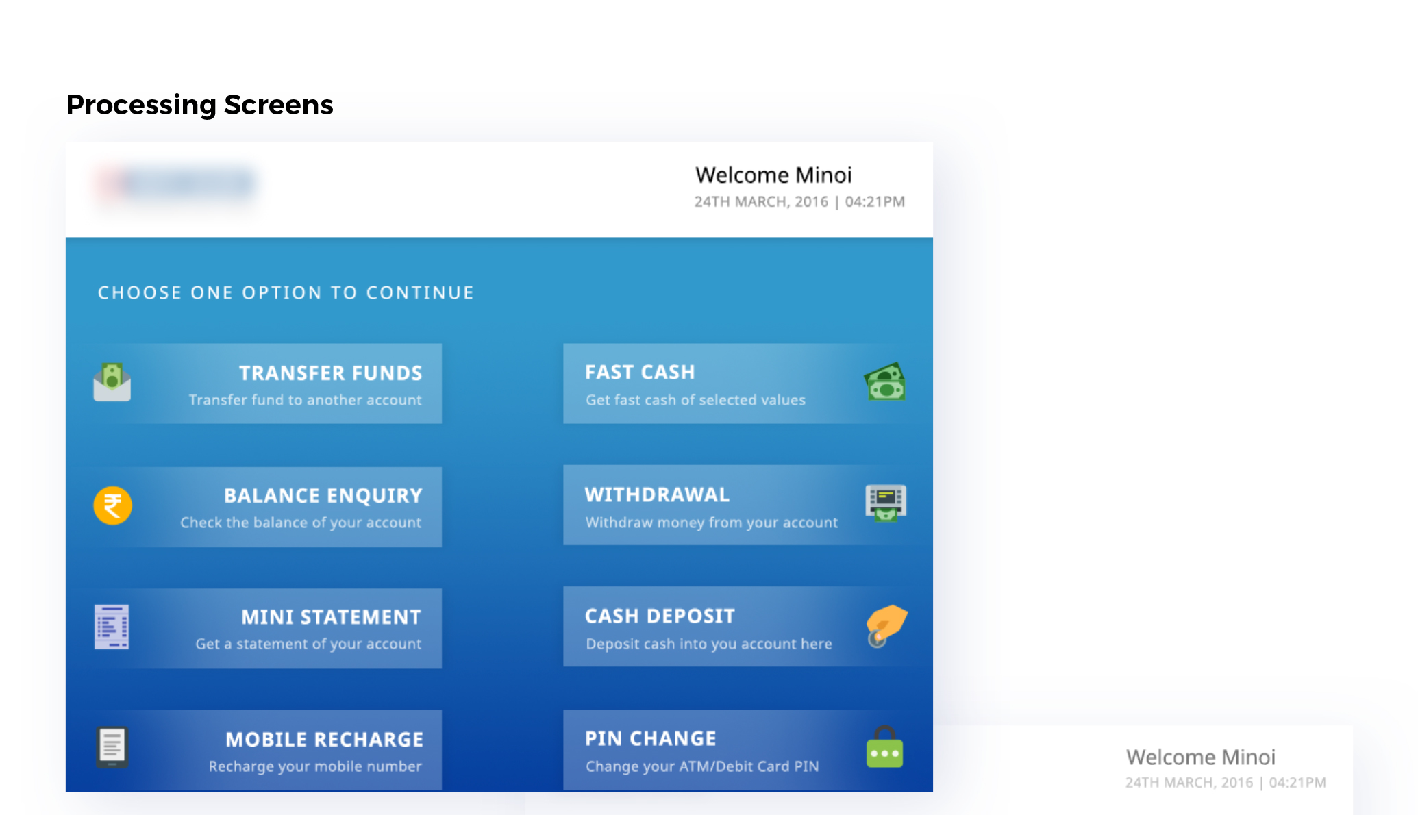
Example ATM System
Using prototype technique to elicit requirements
Login screen

Slide 38

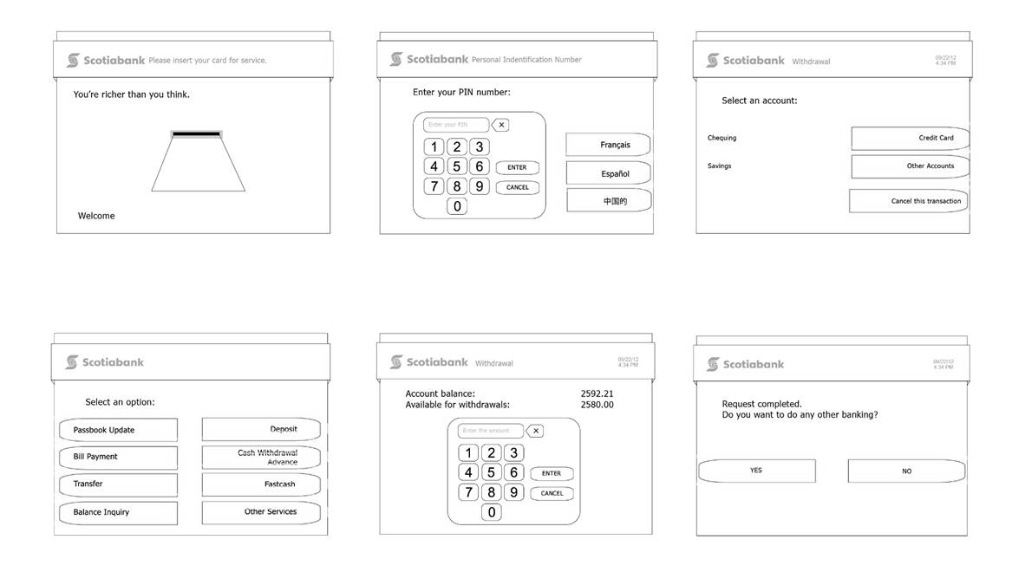
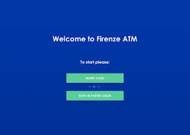

Slide 39
Unlock Your Potential: Tips for Tutorial Success (in the lecture)
Case Study BB (‘Bookish Bliss’ Case study)

Slide 40

Q & A

Slide 41
NEXT WEEK
Process Modelling

Slide 42
Thank you

